Slide 1
SECURE DATA HIDING IN IMAGES USING STEGANOGRAPHY
CAPSTONE PROJECT
Presented By:
Student Name : Akshay Kumar
College Name & Department : Bhagwan Mahavir College , Computer Science

Slide 2
OUTLINE
Problem Statement
Technology used
Wow factor
End users
Result
Conclusion
Git-hub Link
Future scope

Slide 3
Problem Statement
In the digital age, secure communication is crucial. Traditional encryption methods can attract unwanted attention, making steganography a valuable alternative. This project focuses on hiding secret messages within images to ensure confidentiality and prevent unauthorized access. By leveraging Flask and OpenCV, it provides a user-friendly interface for encoding and decoding hidden messages in image files. 🚀

Slide 4
Technology used
🔹 Programming Language: Python 🔹 Framework: Flask (for web application) 🔹 Libraries: OpenCV (image processing), os (file handling) 🔹 Frontend: HTML, CSS 🔹 Platform: Localhost (Flask Server) 🔹 Storage: Local File System (uploads folder)

Slide 5
Wow factors
✅ Stealthy Data Hiding – Uses steganography to embed secret messages inside images without altering their visible quality.
✅ User-Friendly Web Interface – Simple and intuitive Flask-based UI for encoding and decoding messages effortlessly.
✅ Fast & Lightweight – Efficient message embedding and extraction using OpenCV, ensuring minimal processing time.
✅ No External Storage Needed – Stores encoded images locally without relying on databases, ensuring privacy.
✅ Beginner-Friendly Implementation – Clean and well-structured Python code that is easy to understand and modify.
✅ Cross-Platform Compatibility – Works on Windows, Linux, and macOS with minimal setup.

Slide 6
End users
🔹 Cybersecurity Enthusiasts – Those interested in learning and experimenting with steganography for secure communication.
🔹 Students & Researchers – Useful for academic projects, research in cryptography and data security, and exploring hidden data techniques.
🔹 Journalists & Whistleblowers – Can help in securely transmitting sensitive information without attracting attention.
🔹 Forensic Experts – Can analyze and use steganographic techniques for cybersecurity investigations.
🔹 Privacy-Conscious Individuals – Anyone who wants to send hidden messages securely without traditional encryption methods.

Slide 7
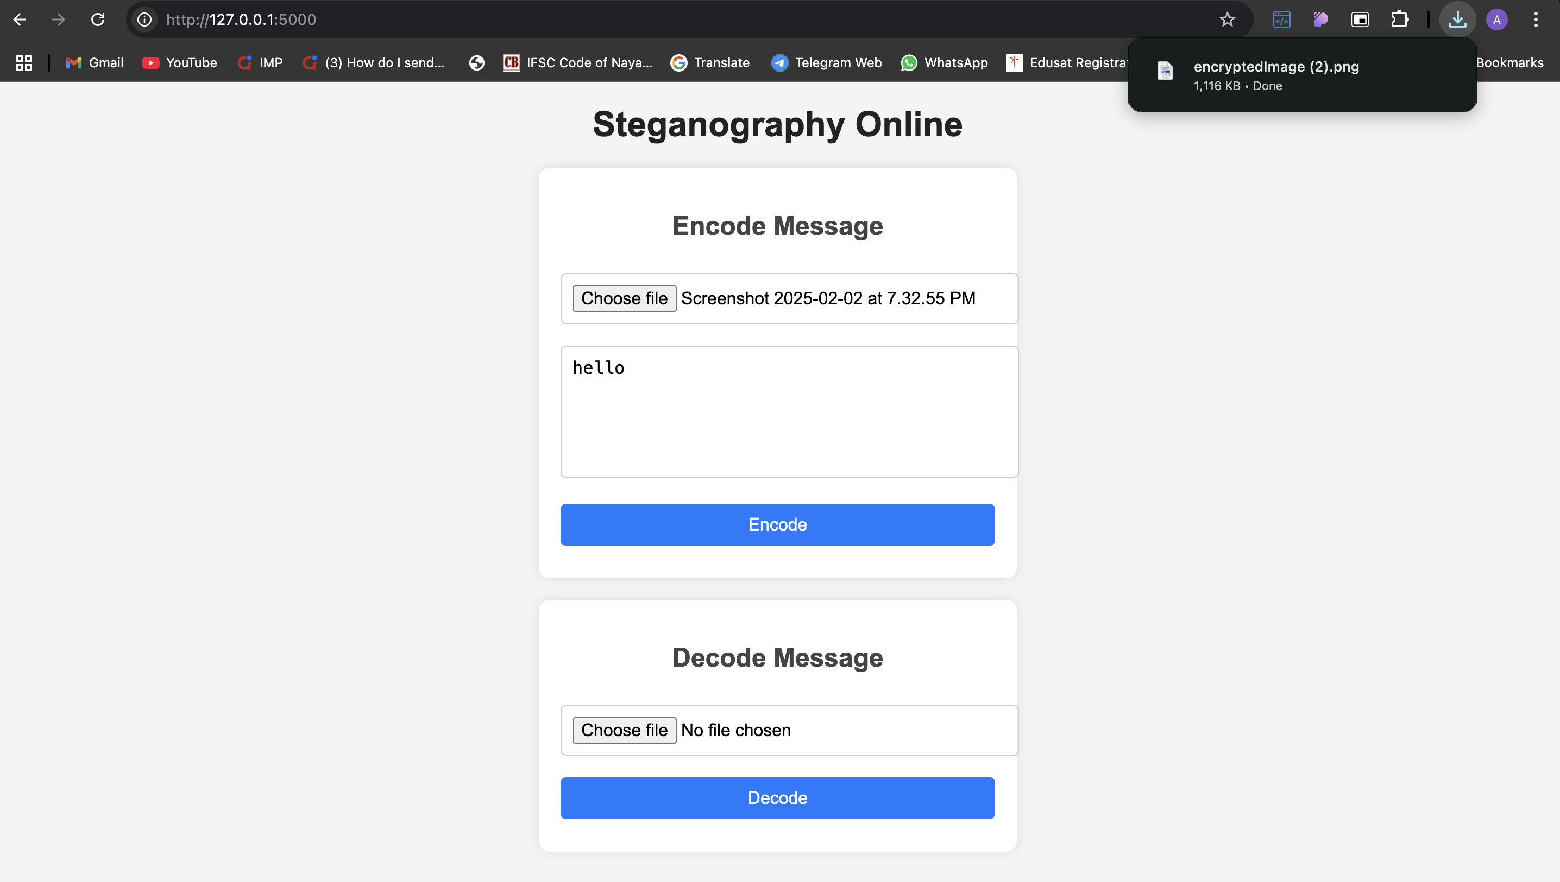
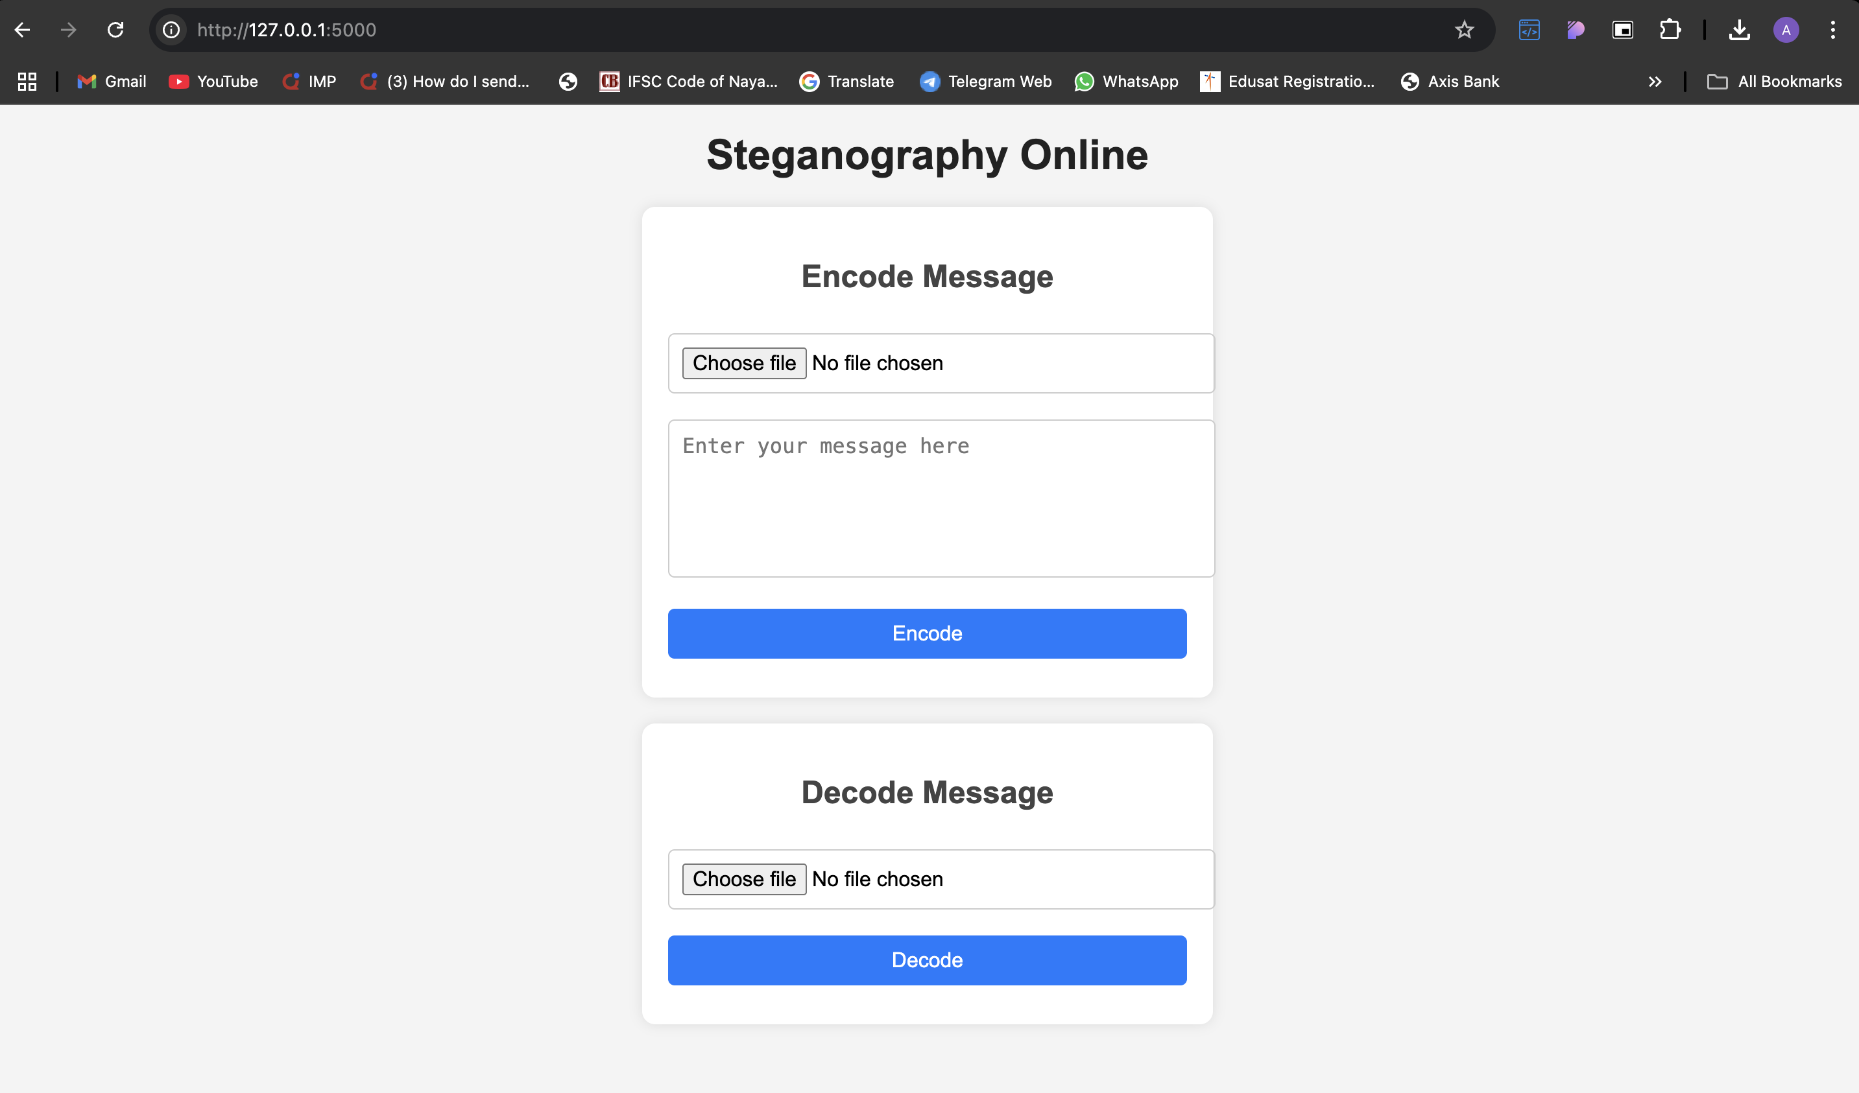
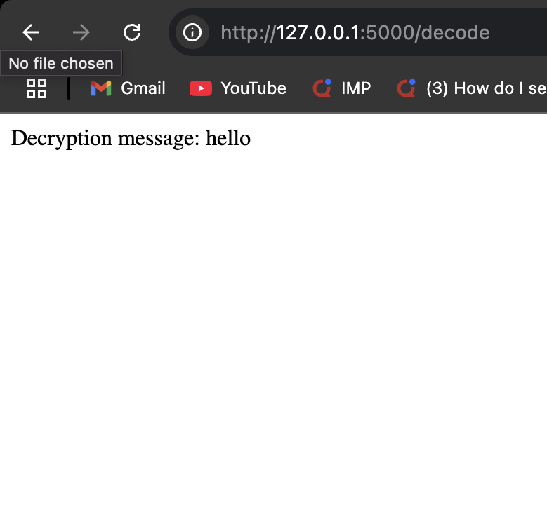
Results
Home Page
Downloaded Image after Encoding
Decrypted Message

Slide 8
Conclusion
This project successfully demonstrates the use of steganography for secure data hiding within images, ensuring confidential communication without raising suspicion. By integrating Flask and OpenCV, we created an intuitive web application that allows users to encode and decode messages seamlessly. This approach provides an alternative to traditional encryption methods, making data transmission more discreet.
With its lightweight, efficient, and user-friendly design, this project serves as a valuable tool for cybersecurity enthusiasts, researchers, and privacy-conscious users. It highlights the importance of covert communication in the modern digital landscape and opens the door for further enhancements in secure data transmission. 🚀🔒

Slide 9
GitHub Link
https://github.com/akshay0611/aicte-ibm-internship.git

Slide 10
Future scope(optional)

Slide 11
THANK YOU

